Slide 1
Exploring Data Mining Techniques In COVID-19 Research
Group 5: Lubna Al Rifaie, Alexandros Ioannou, Cameron Anderson, Luke Aikman

Slide 2
Introduction
COVID-19 pandemic posed unpredictable and difficult challenges.
Data mining techniques were needed to extract knowledge and information from large datasets.
Necessary for:
Tracking the spread of the virus
Predicting outcomes
Responding to the virus

Slide 3
Paper Overview
“Using Data Mining Techniques for COVID-19: A Systematic Review”¹
Application of supervised learning techniques. Natural Language Processing being the most used DM technique.
“Using data mining techniques to fight and control epidemics: A scoping review”²
Supervised learning techniques: Logistic Regression and Classification
Unsupervised learning techniques: Clustering and deep learning approaches

Slide 4
Methods Used
The primary goal of these papers was to compile a list of papers on the use of DM techniques in pandemics.
Natural Language Processing (NLP):
Most used method (22%) in the literature for COVID-19
Disease spread, public sentiment, potential treatments
Supervised Learning:
Most used across studies (90%)
Used to predict disease outcomes and trends
Clustering Algorithms:
Grouping patients based on symptoms or outcomes
Association Rules and Frequent-Itemset Mining:
Used for finding relationships between symptoms or coexisting conditions.
Notes:
NLP: Focusing on analyzing textual data from research publication and social media to extract information on disease spread, public sentiment, and potential treatments

Slide 5
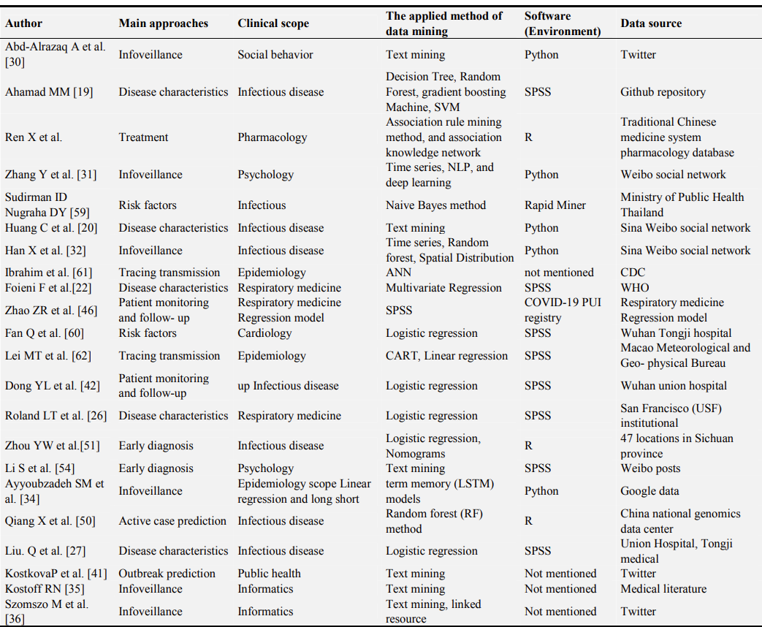
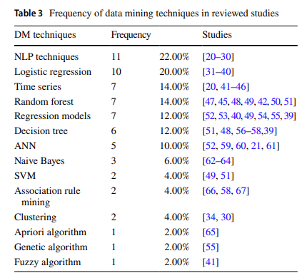
Methods Used
Notes:
NLP: Focusing on analyzing textual data from research publication and social media to extract information on disease spread, public sentiment, and potential treatments

Slide 6
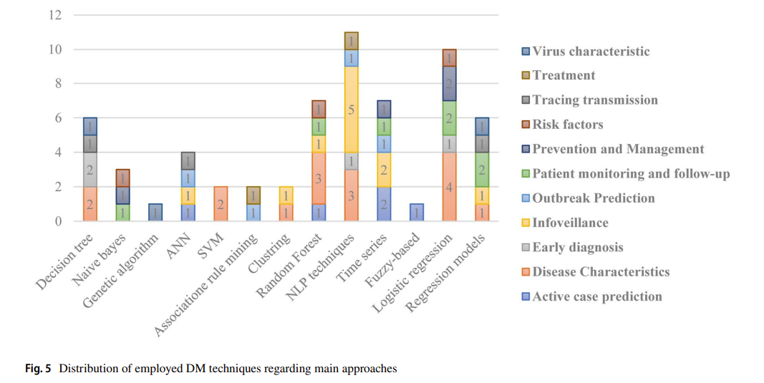
Methods Used
Notes:
NLP: Focusing on analyzing textual data from research publication and social media to extract information on disease spread, public sentiment, and potential treatments

Slide 7
Advantages and Limitations
Advantages:
Diverse Data Handling
Predictive Power
Pattern Recognition
Limitations:
Data Quality
Data Availability
Notes:
NLP: Focusing on analyzing textual data from research publication and social media to extract information on disease spread, public sentiment, and potential treatments
-NLPs are proficient in extracting information from unstructured data sources
-LR and other supervised learning methods have high accuracy in predicting the likelihood of disease outcomes, hospitalization and mortality rates
-Identifications patterns in the data, such as common symptoms or outcomes among COVID-19 patients.
-Reliance on high-quality and diverse datasets. The effectiveness of DM techniques is limited based on the availability and reliability of the data.
-Integrating diverse sources and expertise to improve outcomes.

Slide 8
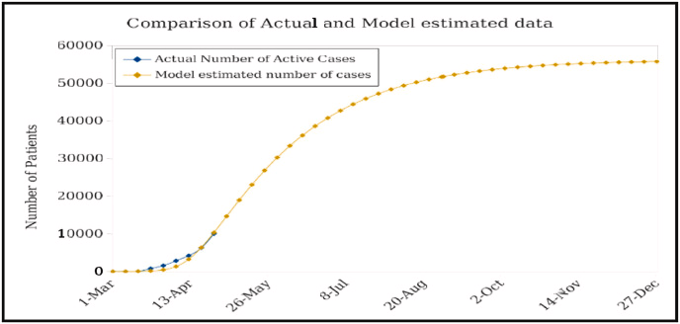
Paper Overview
“Using data mining techniques deep analysis and theoretical investigation of COVID-19 pandemic”
Focused on covid-19 human body data in Iraq
Application of K-Means Clustering

Slide 9
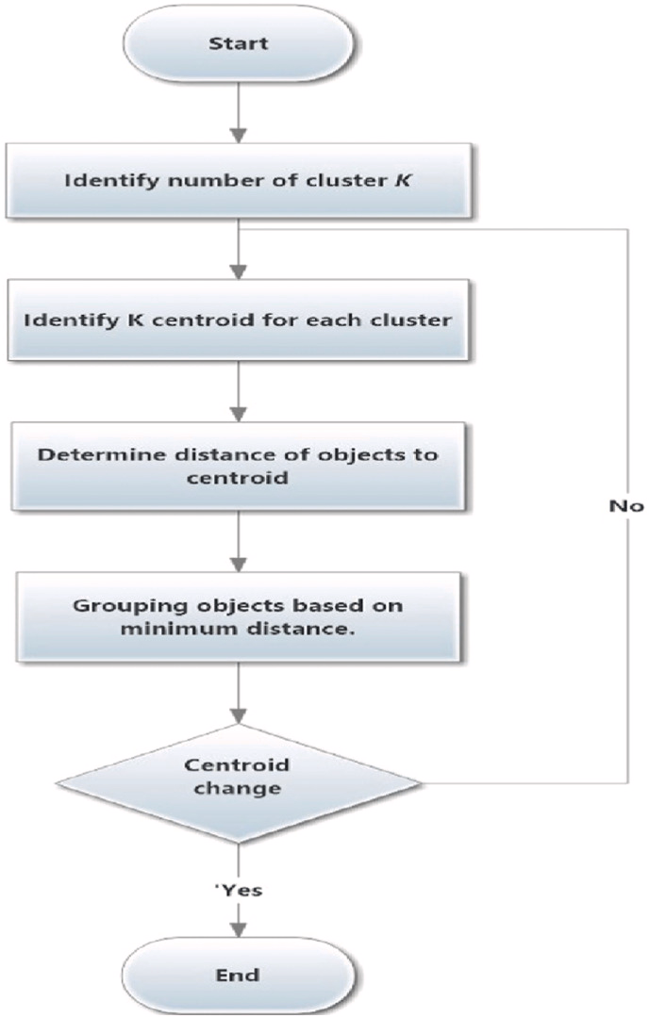
Analysis
Advantages
Lower parameter, less intense model preferred
Limitations
Occasionally K-Means will evaluate irrelevant information or ignore essential facts
Data accessibility

Slide 10
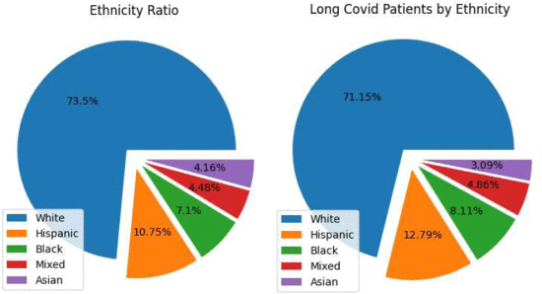
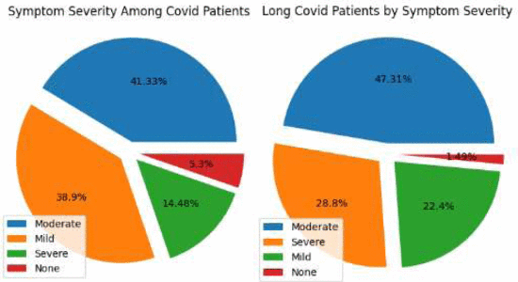
Paper Overview
“Mining Big Healthcare Data to Predict Long COVID Cases”
Focuses on predictions post COVID
Demographic and symptom analysis
Frequent Itemsets and Association Rules

Slide 11
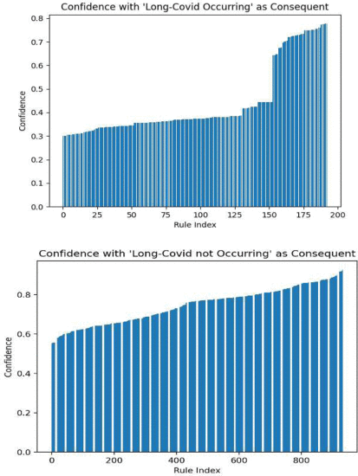
Analysis
Advantages
Combination of different classifications of data can provide better results
Limitations
Few studies on long COVID and the combination of demographic and symptom data

Slide 12
Paper Overview
“K-Means Clustering Identifies Diverse Clinical Phenotypes in COVID-19 Patients”
Identify patients with similar viral stats
Mortality associated with use or not of antivirals in hospitalized covid 19 patients
Elbow method determined best number of clusters to be 5

Slide 13
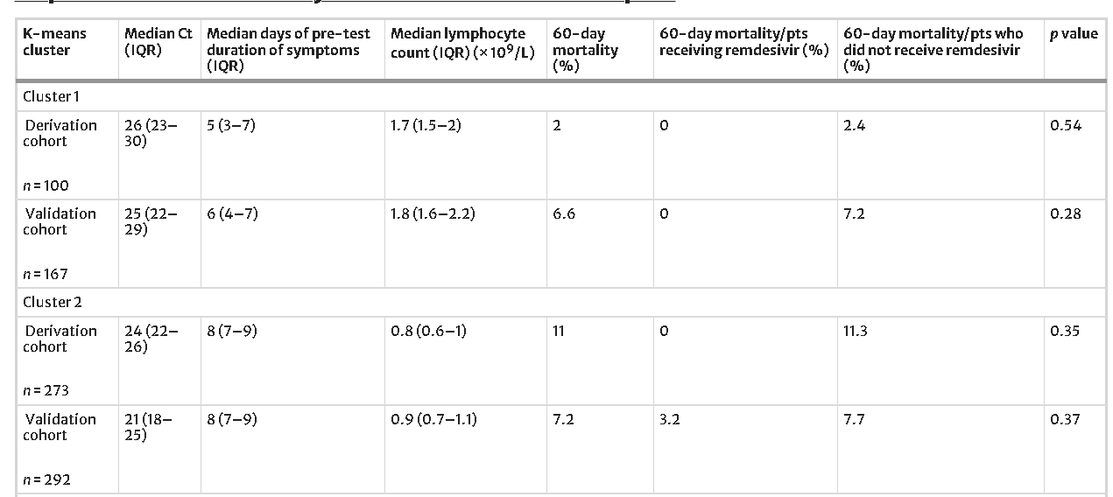
Main characteristics of Clusters

Slide 14
Paper Overview
“Artificial Intelligence -based support for model for new drug development planning
New drug development success is currently very low
The approach taken combines association rules, collaborative filtering and content-based filtering approaches
Applied to see the success probability of a company developing a new covid vaccine

Slide 15
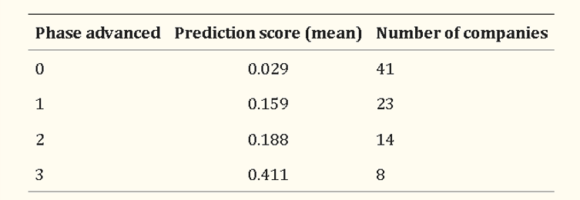
Comparison of Degree of Advancement in Clinical Trial Phase with Prediction Score

Slide 16
Introduction to Medical Data Analysis
“Big data analytics for preventive medicine”
Unlocking Insights, Improving Care, and Reducing Costs
Overview of the complexity and importance of medical data analysis.

Slide 17
Challenges in Healthcare Data Analysis
Interoperability
Resource Constraints
Complexity of Healthcare Systems
Adoption Barriers
Data Volume
Data Variety
Data Quality
Data Privacy and Security

Slide 18
Advantages of Using Data Analytics in Disease Prevention:
Early Detection
Personalized Medicine
Predictive Analytics
Evidence-Based Decision Making
Cost Savings
Continuous Improvement
Population Health Management

Slide 19
Role of Data Analytics in Disease Prevention:
Importance of Disease Prevention
Emphasize the significance of disease prevention in healthcare.
Role of Data Analytics in Disease Prevention
Data analytics can contribute to disease prevention by efficiently analyzing large volumes of complex healthcare data.

Slide 20
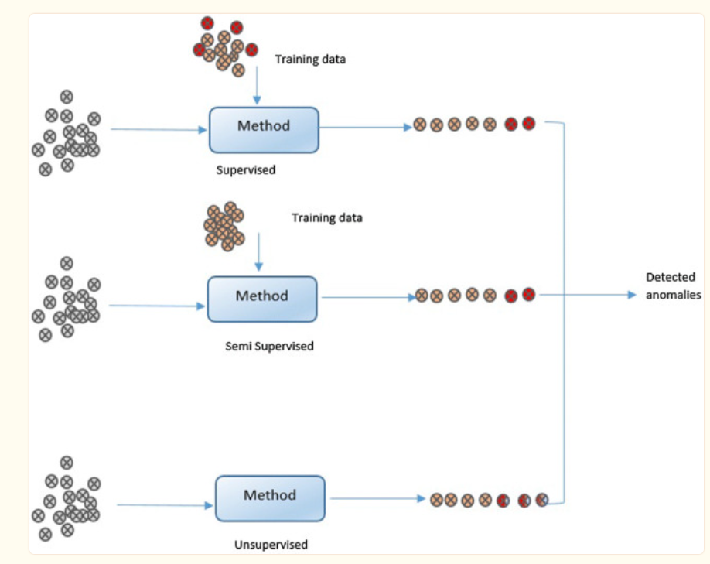
Anomaly Detection in Data Mining Methods

Slide 21
Thanks for Listening!
Any Questions?

Slide 22
References
Ghosh, S., & Das, L. C. (2022). Using Data Mining Techniques for COVID-19: A Systematic Review. International Journal on Data Science and Technology. https://sciencepublishinggroup.com/article/10.11648/j.ijdst.20220802.11
Safdari, R., Rezayi, S., Saeedi, S., Tanhapour, M., & Gholamzadeh, M. (2021). Using data mining techniques to fight and control epidemics: A scoping review. Health and Technology. https://www.ncbi.nlm.nih.gov/pmc/articles/PMC8102070/
Allmuttar, A. Y. O., & Alkhafaji, S. K. D. (2023, June). Using data mining techniques deep analysis and theoretical investigation of covid-19 pandemic. Measurement. Sensors. https://www.ncbi.nlm.nih.gov/pmc/articles/PMC10017173/#bib30
K. Dotzlaw, R. Dotzlaw, C. K. Leung, A. G. M. Pazdor, S. Szturm and D. Tan, "Mining Big Healthcare Data to Predict Long COVID Cases," 2023 IEEE International Conference on Industrial Technology (ICIT), Orlando, FL, USA, 2023, pp. 1-6, doi: 10.1109/ICIT58465.2023.10143145.
Razzak, M. I., Imran, M., & Xu, G. (2020). Big Data Analytics for Preventive Medicine. Neural computing & applications. https://www.ncbi.nlm.nih.gov/pmc/articles/PMC7088441/
Garcia-Vidal, C., Teijón-Lumbreras, C., Aiello, T.F. et al. K-Means Clustering Identifies Diverse Clinical Phenotypes in COVID-19 Patients: Implications for Mortality Risks and Remdesivir Impact. Infect Dis Ther (2024). https://doi.org/10.1007/s40121-024-00938-x

Slide 23
References
Jung YL, Yoo HS, Hwang J. Artificial intelligence-based decision support model for new drug development planning. Expert Syst Appl. 2022 Jul 15;198:116825. doi: 10.1016/j.eswa.2022.116825. Epub 2022 Mar 8. PMID: 35283560; PMCID: PMC8902892.

